Slide 1
Petition #4644
Zoning Board of Appeals Meeting – November 12, 2024

Slide 2
zoning Petition #4644
“Big timber solar”
APPLICANT
Robert McNeill on behalf of Big Timber Solar Farm, LLC
PROPERTY OWNER
Home State Bank National Association Trustee Et Al, Trust #5141
ACTION REQUESTED
A Special Use Permit in the F-Farming Zoning District to allow for the development of a commercial solar energy facility.
SUBJECT PROPERTY
Southeast corner of the intersection of IL Route 72 (Higgins Road) and County Highway 21 (Big Timber Road) in Rutland Township (02-22-400-014)

Slide 3
Special Use Permit Application
September 26, 2024
  An Application for a Special Use Permit with the Petitioner’s Findings of Fact dated September 26, 2024
  An ALTA/NSPS Land Title Survey dated May 18, 2022
  A Sound Study dated September 20, 2024
  A Site Plan dated September 16, 2024
  A Decommissioning Plan dated September 9, 2024
  A Wetland Delineation Report dated August 20, 2024
  A Licensed Structural Engineer’s Certificate dated September 5, 2024
  A Phase 1 Environmental Site Assessment dated July 3, 2024
  An executed Agricultural Mitigation Impact Agreement with the Illinois Department of Agriculture
  Results and recommendations from the Illinois Dept. of Natural Resources obtained through the Ecological Compliance Assessment Tool dated August 27, 2024
  Results and recommendations from the United States Fish and Wildlife Service obtained through the Information for Planning and Consulting environmental review dated August 30, 2024
  A Natural Resources Inventory Report from the Kane-DuPage Soil & Water Conservation District dated July 24, 2024
  Review Letter from the Illinois State Historic Preservation Office dated September 25, 2024

Slide 4
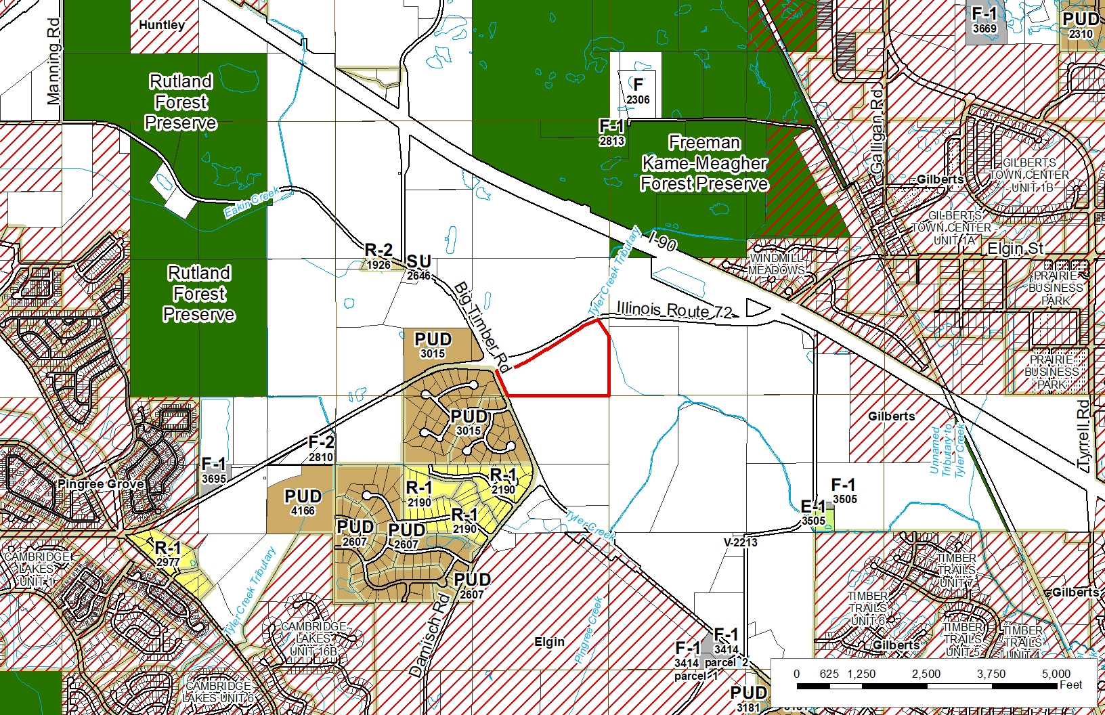
Zoning
ZONING
The subject property is currently zoned F-Farming District. Section 25-8-1-2 of the Kane County Zoning Ordinance provides that “Solar Utility” is a Special Use in the F-Farming District.

Slide 5
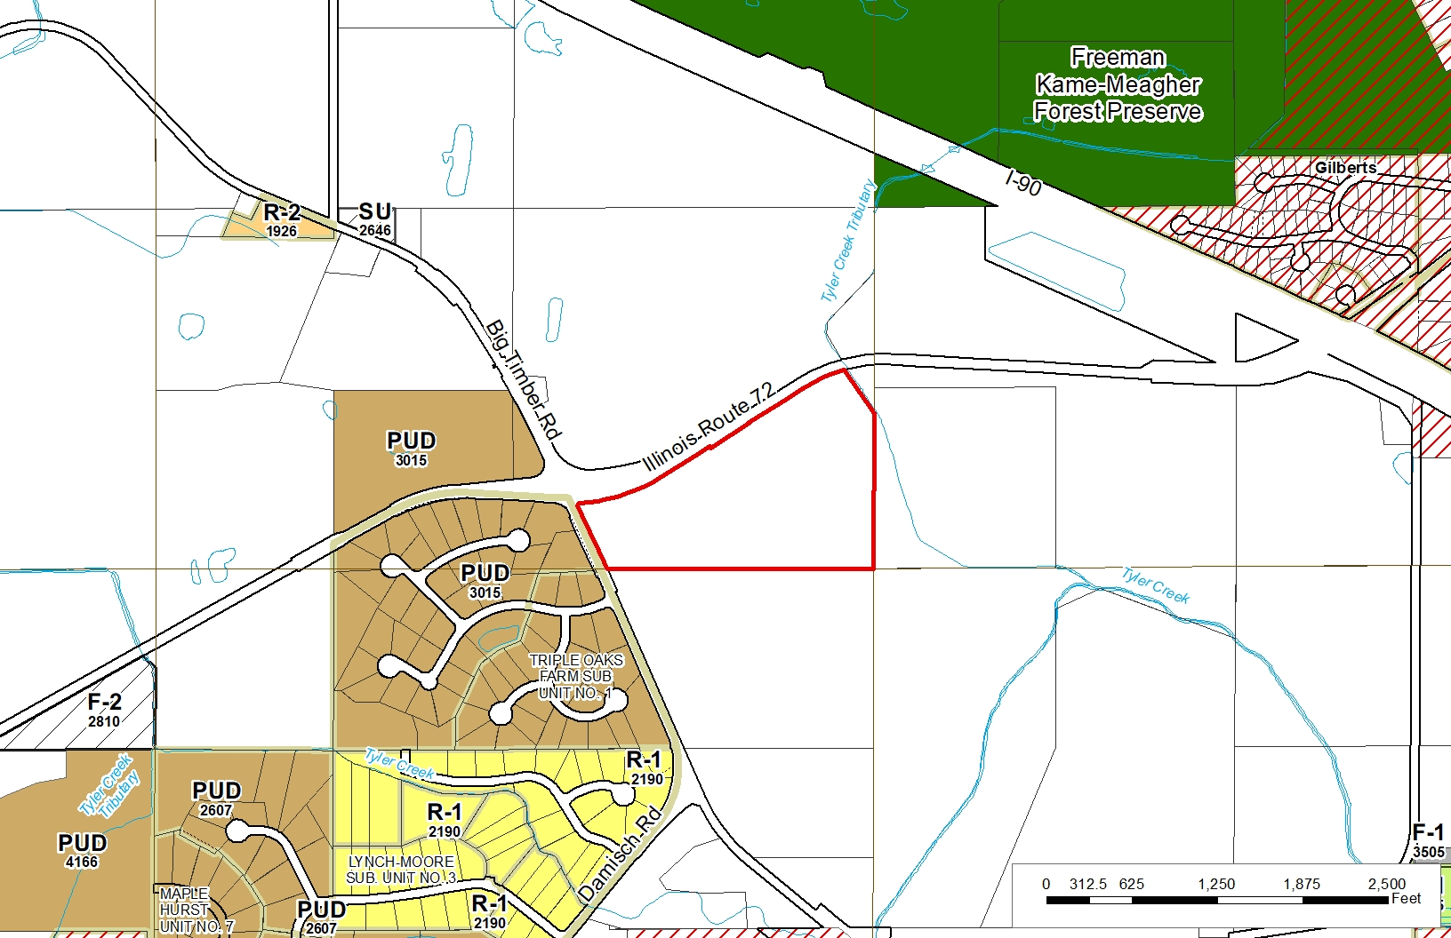
Zoning

Slide 6
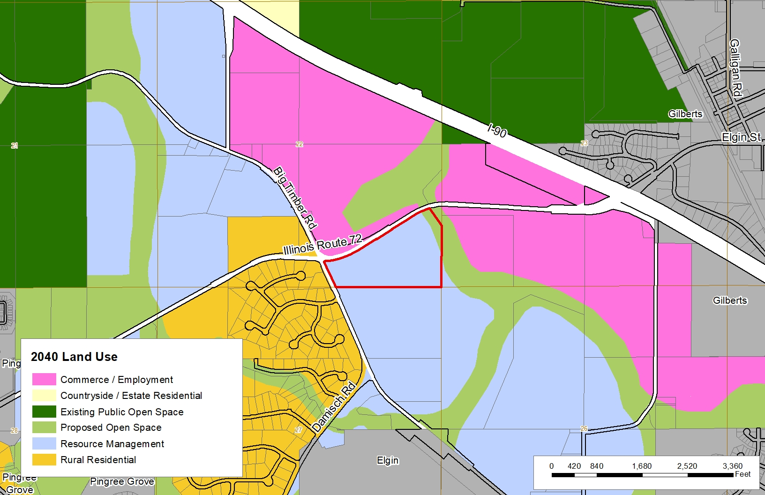
2040 Land Use

Slide 7
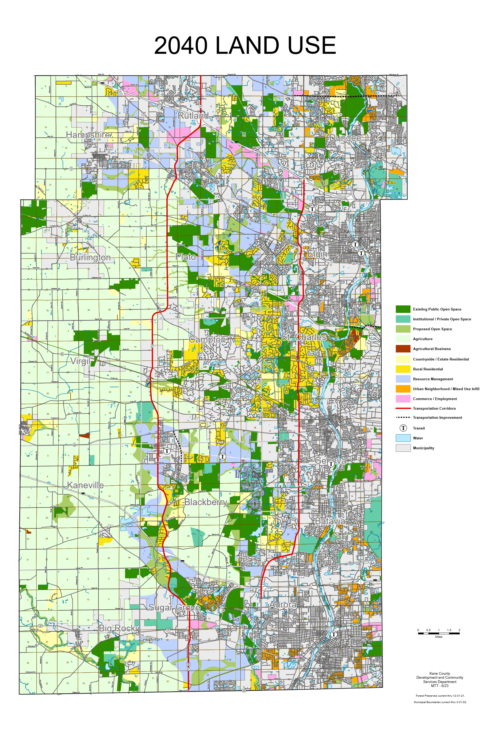
2040 Land Use Analysis
SEC of IL Route 72 and County Highway 21 – Rutland Twp. – Petition #4644
2040 Planned Use: Resource Management
Characteristics of Areas Planned for Resource Management
Resource Management is a land use category that supports municipal and County compact, mixed use growth opportunities while emphasizing wise management of land and water resources
Applies primarily to land within the Critical Growth Area
Much of the growth in the Resource Management category will be the result of municipal annexations and land use decisions and, to a lesser extent, approval by the County as unincorporated development

Slide 8
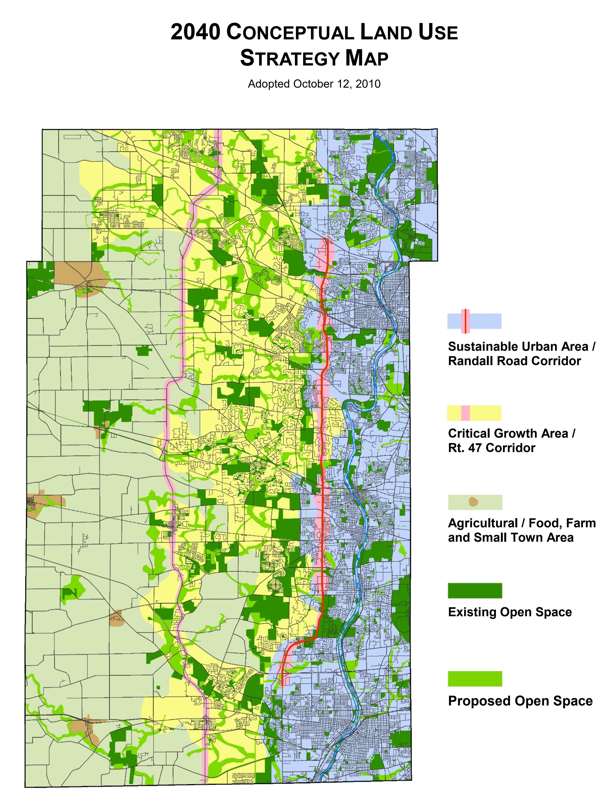
2040 Conceptual Land Use Strategy
SEC of IL Route 72 and County Highway 21 – Rutland Twp. Petition #4644
Land Use Strategy Area:
Critical Growth Area / Rt. 47 Corridor
Core Themes
The Critical Growth Area continues to be where Kane County and the fast growing municipalities of the past two decades face the greatest challenges to sensible, managed growth
The Critical Growth Area is characterized by diversity and mix of planned municipal development, expanded transportation opportunities, additional open space initiatives, natural resource driven decision-making and healthy living
The Conceptual Land Use Strategy Map:
A general land use map that divides the county into 3 major geographic corridors, each with unique land resources, development patterns, and planning opportunities.

Slide 9
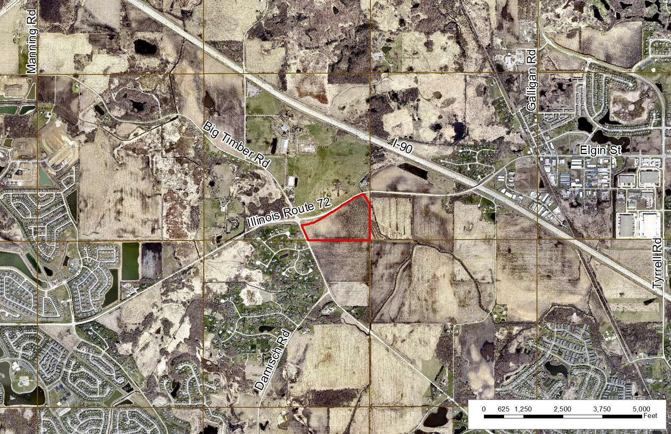

Slide 10
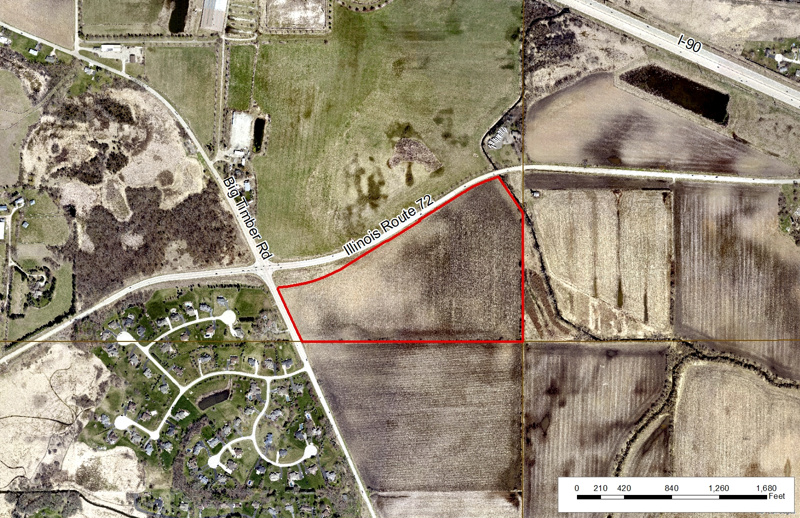

Slide 11
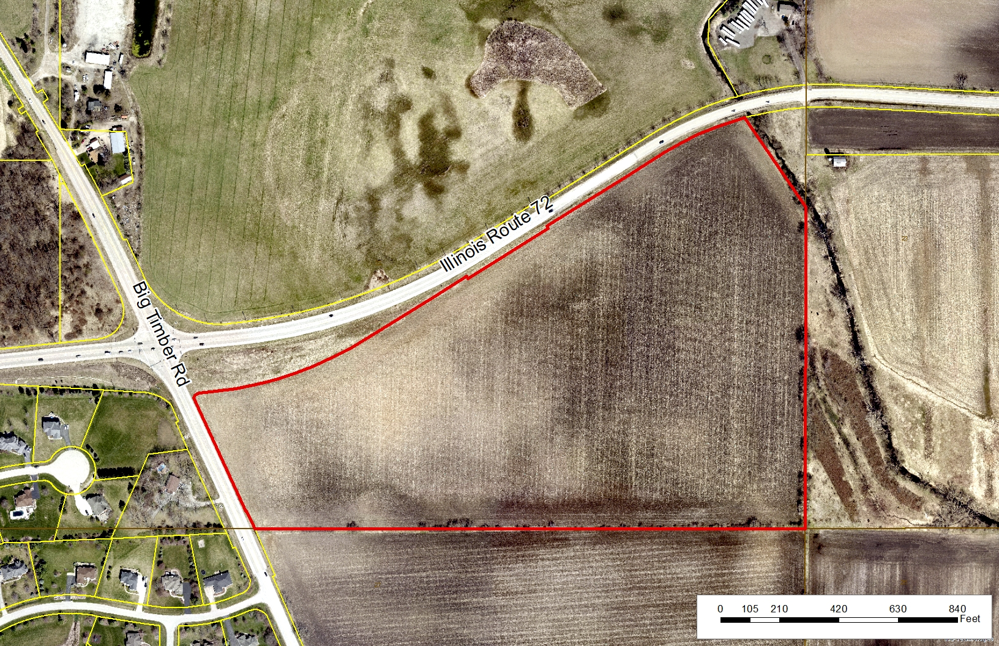

Slide 12
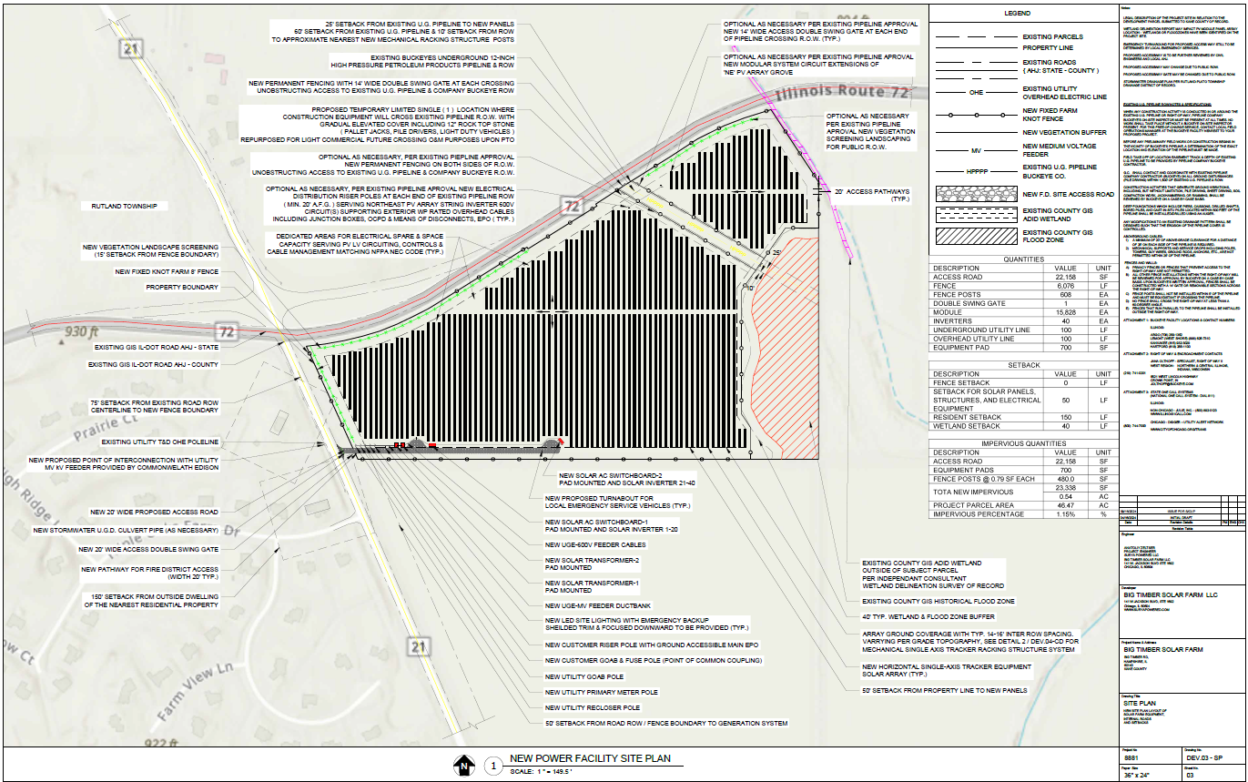
Site Plan

Slide 13
Site Plan

Slide 14
Setbacks Requirements
Code Requires:
Site Plan Provides:
The Commercial Solar Energy Facility shall be sited as follows, with setback distances measured from the nearest edge of any component of the facility:
(1) Occupied Community Buildings and Dwellings on Nonparticipating Properties: one hundred fifty (150) feet to the nearest point on the outside wall of the structure.
(2) Boundary Lines of Participating Property: None.
(3) Boundary Lines of Nonparticipating Property: fifty (50) feet to the nearest point on the property line of the nonparticipating property.
(4) Public Road Rights-of-Way: fifty (50) feet to the nearest edge of the public road right-of-way.
75' SETBACK FROM EXISTING ROAD ROW CENTERLINE TO NEW FENCE BOUNDARY
50' SETBACK FROM ROAD ROW / FENCE BOUNDARY TO GENERATION SYSTEM
50' SETBACK FROM PROPERTY LINE TO NEW PANELS
40' TYP. WETLAND & FLOOD ZONE BUFFER
150' SETBACK FROM OUTSIDE DWELLING OF THE NEAREST RESIDENTIAL PROPERTY

Slide 15
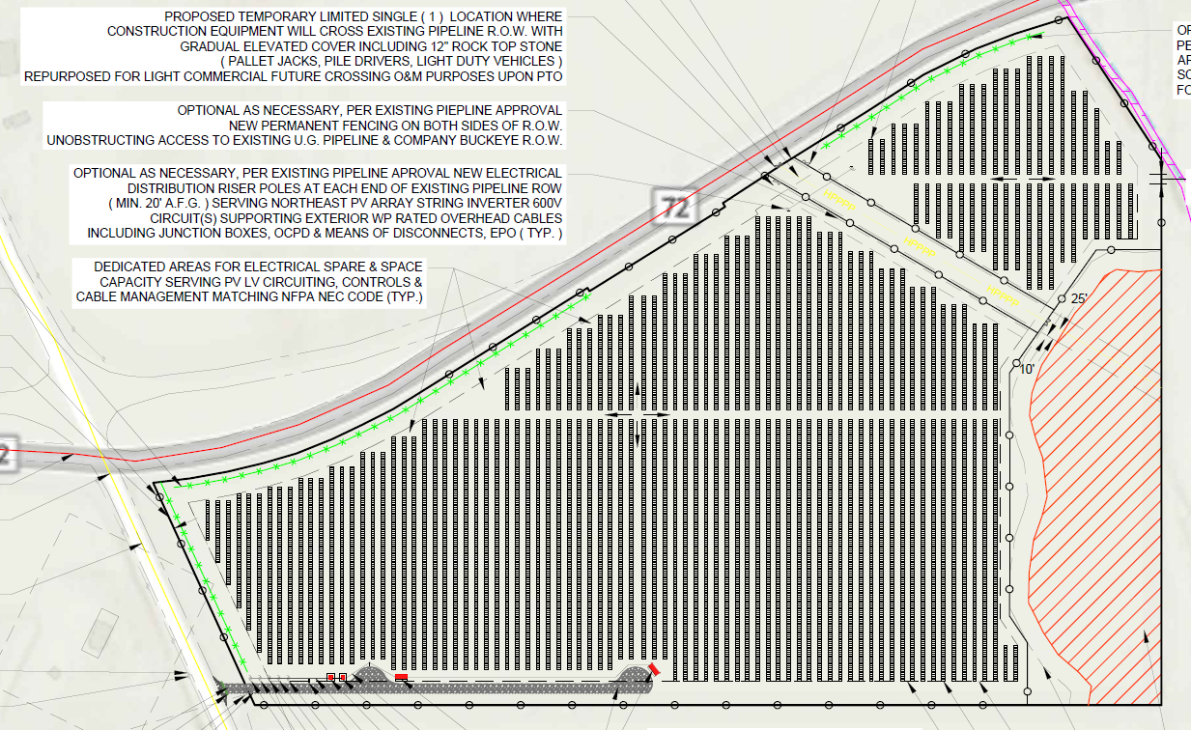
Landscaping/Vegetation
Vegetative Screening Requirements
A vegetative screen shall be provided for any part of the Commercial Solar Energy Facility that is visible to Non-participating Residence(s).
The landscaping screen shall be located between the required fencing and the property line of the participating parcel upon which the facility sits.
The vegetative screening shall include a continuous line of native evergreen foliage and/or native shrubs and/or native trees and/or any existing wooded area and/or plantings of tall native grasses and other native flowering plants.
VEGETATION LANDSCAPE SCREENING (15' SETBACK FROM FENCE BOUNDARY)

Slide 16
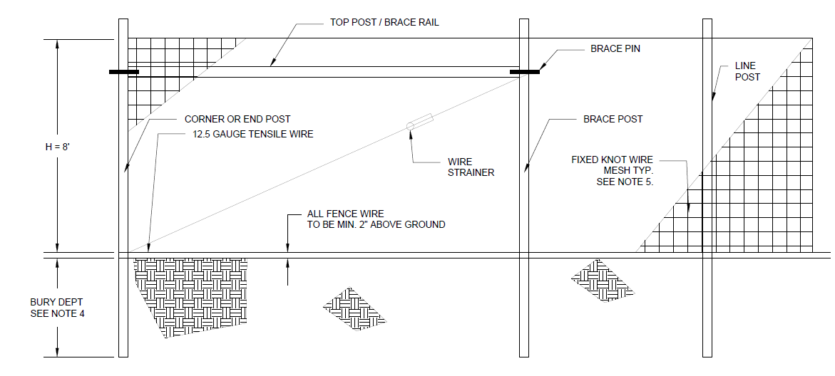
Fence Detail
Fencing: A fence of at least eight (8) feet and not more than twenty-five (25) feet in height shall enclose and secure the Commercial Solar Energy Facility.

Slide 17
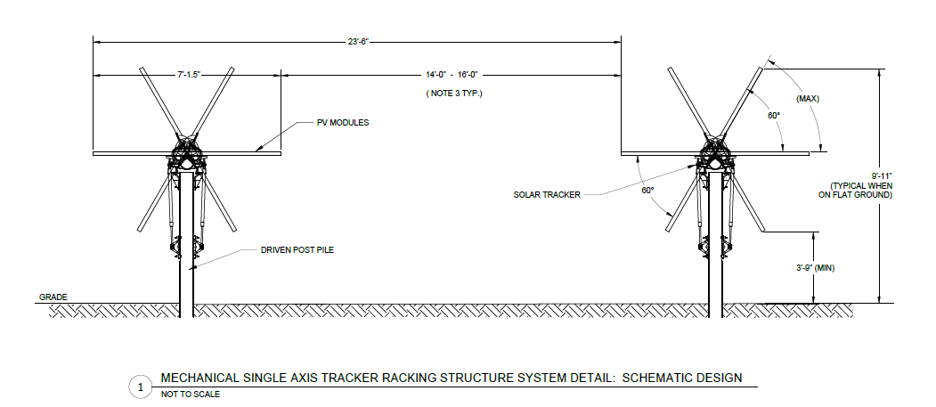
Racking Structure Detail
Height: No component of a solar panel, cell or modules may exceed twenty (20) feet in height above the ground at full tilt.

Slide 18
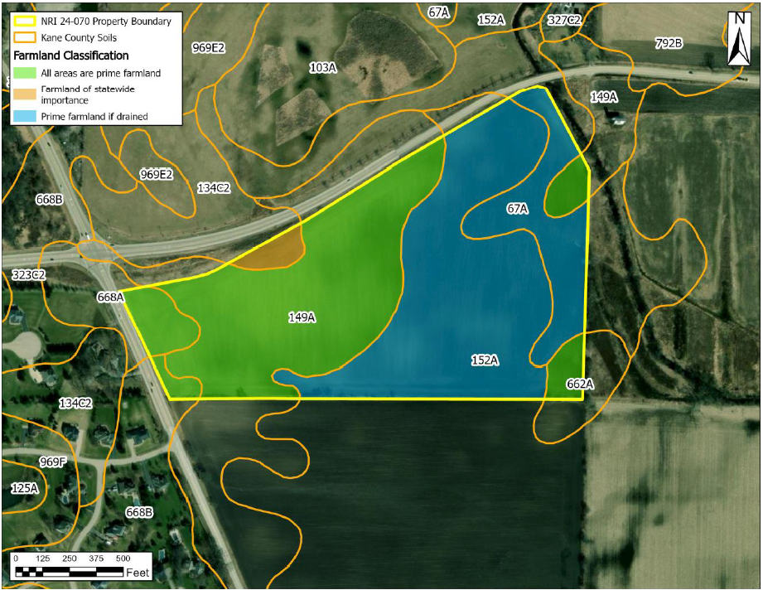
NRI Report – Prime Farmland Map
LESA SCORE:
LESA is designed to determine the quality of land for agricultural uses and to assess a site for long term agricultural economic viability. The LESA is a 100-point maximum numerical value based on two parts – Land Evaluation (LE) and Site Assessment (SA). The LE is based upon the inherent ability of the soils of a parcel to produce commonly grown crops. The LE counts as 1/3 of the total score. The SA is a value based on the proximity of the parcel to agricultural areas. Parcels further from developed areas rank higher for protection. The SA counts for 2/3 of the LESA score.
Of this parcel, 1.8 percent or 0.9 acres are considered Farmland of Statewide Importance.
The LE value for this site is 33 and the SA value is 31 for a total LESA score of 64.
This score represents Low Protection effort warranted.

Slide 19
KDOT Stipulations
Memo from the Kane County Department of Transportation dated October 6, 2024 stating they will require the applicant to apply for a Temporary Construction Access and a Minimum Use Access permit.

Slide 20
Kane County Water Resources Stipulations
  Water Resources will require a stormwater permit for this development.
  An Engineer’s report will be required. Should the site introduce more than 25,000 sq ft of impervious area or more than 3 acres of disturbance, stormwater detention will be required. This impervious area is calculated cumulatively since 2002 for a site as per the Stormwater Ordinance. The Engineer’s report must demonstrate that the peak flow for the site with the proposed development is not increased, stormwater detention may be required for the development to ensure this. Any required Stormwater Detention Management will require a viable outfall and may require off-site work.
  Should the site introduce more than 5,000 sq ft of impervious, a BMP will be required for all impervious surfaces.
  A calculation for disconnected impervious area, created by the panels, will be required. A Best Management Practice will be required to encourage infiltration of runoff within the site.
  A drain tile study will be required, including upstream and downstream tile systems that rely on the drain tiles within the site. Water Resources is looking for the protection of the tile system that is in place, including but not limited to replacement in kind and observation and cleanout structures.
  Plantings within the development will not interfere with drain tiles. Planting plan should address the placement of vegetation and trees with long root systems that can interfere with tile systems and cause off site issues including surcharged drain tiles and blow outs of the drain tile systems.
  Soil samples shall be taken every 2 years from the site and analyzed for physical, chemical, and biological properties to demonstrate the soil health within the solar installations.
  80% vegetative coverage for plantings will be a requirement for the site.
  A Wetland Delineation will be required. Any Wetland Impacts must be mitigated.
  Any fill in depressional areas will require Compensatory storage. Including fill created by solar racking.
  Floodplain, Wetland, Compensatory Storage, BMPs and Stormwater Management must be placed in a Conservation or Drainage Easement.

Slide 21
Petition Opposition
Memo from Kent Damisch dated October 24, 2024 expressing opposition to Petition 4644
Memo from the Village of Gilberts dated October 22, 2024 with a resolution approved by the Village of Gilberts Village Board stating the Village’s opposition and protest to the special use application

Slide 22
Special Use Permit – Findings of Fact
The six factors for granting a Special Use per the Kane County Zoning Ordinance (Section 4.8-2)
That the establishment, maintenance or operation of the Special Use will not be unreasonably detrimental to or endanger the public health, safety, morals, comfort or general welfare.
That the Special Use will not be injurious to the use and enjoyment of other property in the immediate vicinity for the purposes already permitted, not substantially diminish and impair property values within the neighborhood.
That the establishment of the Special Use will not impede the normal and orderly development and improvement of surrounding property for uses permitted in the district;
That adequate utility, access roads, drainage and/or other necessary facilities have been or are being provided;
That adequate measures have been or will be taken to provide ingress and egress so designed as to minimize traffic congestion in the public streets and roads;
That the Special Use shall in all other respects conform to the applicable regulations of the district in which it is located, except as such regulations may in each instance be modified by the Kane County Board pursuant to the recommendations of the Kane County Zoning Board of Appeals.

Slide 23
Meeting Schedule:
Regional Planning Commission: N/A
Zoning Board of Appeals: November 12, 2024
Development Committee: November 19, 2024
Kane County Board: December 10, 2024
Petition 4644, the subject of this public hearing, will be considered by the Kane County Development Committee at its upcoming meeting currently scheduled for 10:30 a.m., Tuesday, November 19, 2024, in the County Board Meeting Room, Building A, 2nd Floor, of the Kane County Government Center, 719 S. Batavia Ave., Geneva, Illinois. Persons in favor of or in opposition to this petition who wish to speak before the Development Committee must signify their intention to do so by signing a sheet provided for such purpose at the meeting at which such petition is to be considered.
Petition 4644, the subject of this public hearing, will be considered by the County Board at its upcoming meeting currently set for 9:45 a.m., Tuesday, December 10, 2024 in the County Board Meeting Room, Building A, 2nd Floor, of the Kane County Government Center, 719 S. Batavia Ave., Geneva, Illinois. Persons in favor of or in opposition to this petition who wish to speak before the County Board must file their intention to do so with the Zoning Enforcement Officer no later than the Friday preceding the County Board meeting at which the petition is to be considered.

